Slide 1

Early prediction of sepsis using clinical data
1
Jeroen Vastmans & Rui Zhu
Faculity of Engineering Technology
[1] http://netlingua-salford.co.uk/services/medical-translation/
Notes:
Jeroen

Slide 2
Overview
Introduction
Problem description
Goals
Research
Experiments
Conclusion
Notes:
Jeroen
Briefly talk about it,

Slide 3
Overview
Introduction
Problem description
Goals
Research
Experiments
Conclusion
Notes:
Jeroen

Slide 4
Introduction
Develop algorithm
Predict sepsis onset (medical condition)
Based on PhysioNet Challenge [1]
Trying to match “benchmark” score
[1] Reyna, Matthew, et al. "Early Prediction of Sepsis from Clinical Data -- the PhysioNet Computing in Cardiology Challenge 2019" (version 1.0.0). PhysioNet (2019), https://doi.org/10.13026/v64v-d857 https://physionet.org/content/challenge-2019/1.0.0/
Notes:
In this thesis, we will with 2 develop algortihm to predcict onset of sepsis
Based ourselves on dataset on challenge in the past
Try to match the score

Slide 5



Introduction
Source of infection
Blood Leaking
Organ Failure
What is Sepsis?
Animations : https://dribbble.com/shots/2391923-Sepsis-002
Notes:
Rui: too fast
Sepsis, also called“blood poisoning” ,is a life-threatening condition. It is an inflammatory immune response triggered by an infection. It always leads to blood leaking and finally organ failure.

Slide 6

Introduction
1
3 levels of severity:
Sepsis – 30% mortality
Severe sepsis – 50% mortality
Septic shock – 80% mortality
2
[1] http://ww.differencebetween.net/science/health/difference-between-sepsis-and-septic-shock/
[2] https://www.topneurodocs.com/sepsis/
Notes:
Rui:
Sepsis occurs when chemicals released into the bloodstream to fight an infection trigger inflammatory responses throughout the body.
Inflammatory responses throughout the body can damage vital organs.
Thus, it is very dangerous and life threatening.
There are 3 levels of sepsis: sepsis, severe sepsis, and septic shock, .

Slide 7

Introduction
†
Sepsis is a main death cause.
One-hour delay of treatment [1]
→ 3.6 - 9.9% ⇑ mortality
Early detection & prediction!
† P. E. Marik, ‘Early Management of Severe Sepsis: Concepts and Controversies’, CHEST, vol. 145, no. 6, pp. 1407–1418, Jun. 2014, doi: 10.1378/chest.13-2104.
[1] Kumar, Anand et al. “Duration of hypotension before initiation of effective antimicrobial therapy is the critical determinant of survival in human septic shock.” Critical care medicine vol. 34,6 (2006): 1589-96. doi:10.1097/01.CCM.0000217961.75225.E9
Notes:
Rui:
Sepsis is a main death cause. Every year, many people suffer and die from sepsis.
From historical records,, every 2.8 seconds one patient die from sepsis globally.
Luckily, early detection and treatment can help to improve sepsis outcomes significantly.
From the former research paper, it has been well known that each hour of delayed treatment is associated with roughly an 3.6-9.9% increase in mortality rate .
So, it is of vital importance to detect or predict sepsis early.

Slide 8
Overview
Introduction
Problem description
Goals
Research
Experiments
Conclusion
Notes:
Rui
Next, my colleague Jeroen, will introduce the problem description for our thesis.

Slide 9
Problem description
Major health concern with significant mortality, and healthcare expenses
Early detection + antibiotic treatment of sepsis → outcomes
Algorithm evaluated using novel utility score [1]
Only timely and correctly prediction will succeed
Too early and too late predications penalized
Other metrics are discussed in thesis
Patient data
Algorithm
Calculate Sepsis risk
Timely sepsis prediction
[1] Reyna, Matthew, et al. "Early Prediction of Sepsis from Clinical Data -- the PhysioNet Computing in Cardiology Challenge 2019" (version 1.0.0). PhysioNet (2019), https://doi.org/10.13026/v64v-d857 https://physionet.org/content/challenge-2019/1.0.0/
Notes:
Jeroen
Likely previously mentioned, sepsis is a major health concern
The early detection of sepsis is the key to help healthcare workers in starting up an efficient treatment for the patient
4-8% increase in mortality/hour
Late = life-threating
Sepsis prediction for non-sepsis: use limited IC equipment
timely => prediction too earlier, not helpful, use limited resources
utility function that rewards early predictions and penalizes late predictions as well as false alarms.
Sepsis patient= max reward(1,0) 12 before and 3h after Tsepsis
Penalize late

Slide 10
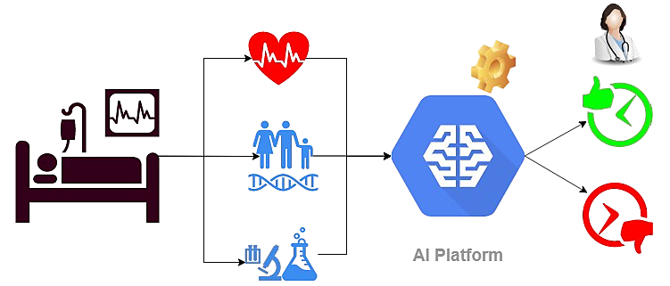
Data description
PhysioNet Challenge
40,336 patients record from 2 different hospitals [1]
Publicly available
Set_A (20,336) & Set_B (20,000)
Hourly taken measurements
Vital Signs (1-8)
Laboratory values (9-34)
Demographics (35-40)
Hourly prediction
[1] Reyna, Matthew, et al. "Early Prediction of Sepsis from Clinical Data -- the PhysioNet Computing in Cardiology Challenge 2019" (version 1.0.0). PhysioNet (2019), https://doi.org/10.13026/v64v-d857 https://physionet.org/content/challenge-2019/1.0.0/
Notes:
Jeroen
Data consists of around 40.000
The available data is taken from 2 hospitals (Set_A and Set_B)
Data consists of 3 blocks of data
Vital signs: hourly taken (Heart rate, temp, Resp rate) (Parameter 1-8)
Laboratory values: daily updated, results of lab tests (blood analysis) (parameter 9-34)
Demographics: data regarding the patient (age, gender, ICU length of stay) (parameter 35-40)
Explain 6 hours ahead
Sepsis labels shifted six hours ahead
Predict sepsis 6 hours early
We will repeat this process for k = 1, 2, …, N hours, where N is the number of hours in a given patient's recording,
In the training data, the sepsis Labels are shifted 6 hours ahead.

Slide 11
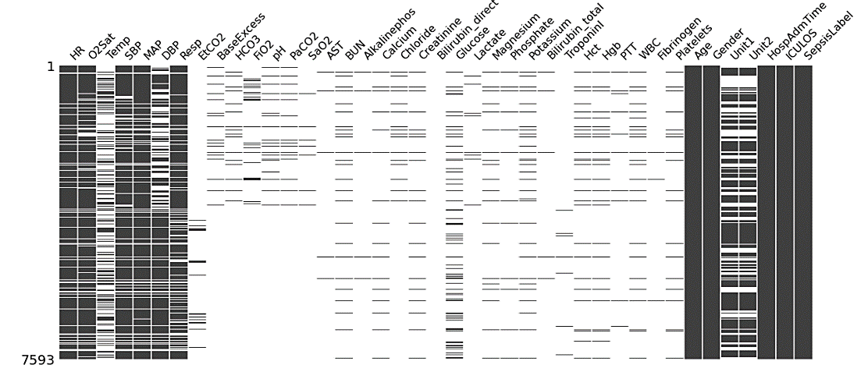
Problem description – Missing data
Vital signs
Laboratory values
Demographics
Sepsis Label
Notes:
Jeroen
They provided the partisans with training data
Tell what one row represents, need to explain all the numbers on this slide
1 line represents 1 hour measurement
Black: Present – White: Absent
Major missing values is in the laboratory data;

Slide 12
Overview
Introduction
Problem description
Goals
Research
Experiments
Conclusion
Notes:
Jeroen
Next Rui will discuss the goals

Slide 13

Goals
Develop an imputing method for missing data
Develop a machine learning algorithm for reliable early detection of sepsis
i/p data
Missing data filling
Model training
Sepsis prediction
Notes:
Rui
Our goal is to first Develop a method for filling the missing data in the given dataset and
then to develop a machine learning algorithm for reliable early detection of sepsis.

Slide 14

Utility Score
The most important evaluation metric
We want the sepsis prediction to be:
accurate, early & in time (6 hours before sepsis onset)
Too early
Too late
Missed
Notes:
Rui:
To evaluate the algorithm, we use the evaluation metrics called the utility score. It is provided by a challenge called PhysioNet Competition, to measure the performances of the different’ algorithms submitted by different participants. For one patient, we want the sepsis prediction to be accurate, early and timely. Too early, too late or missed predictions are unwanted. That’s why we use utility score. We will give an example for it .

Slide 15

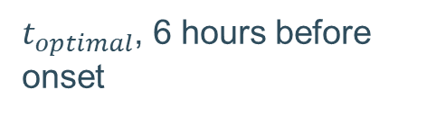

For example - septic patient utility score calculation
Time (hour(s)) | Sepsis Label
1 | 0
2 | 0
3 | 0
… | …
42 | 0
43 | 0
44 | 0
45 | 0
46 | 0
47 | 0
48 | 1
49 | 1
50 | 1
51 | 1
$t_{optimal}$, 6 hours before onset
Good time for sepsis prediction
$t_{sepsis}$ , Sepsis onset
$t_{late}$ , 3 hours after onset
Notes:
Rui
Here is an example for the septic patient’s utility score calculation. You can see he is non septic at first and develop sepsis at hour 48. So tsepsis is 48. The best time to predict sepsis is 6 hours before t sepsis. Thus, T optimal is 42. and t late is 51. Next, we will show how the utility score is calculated

Slide 16
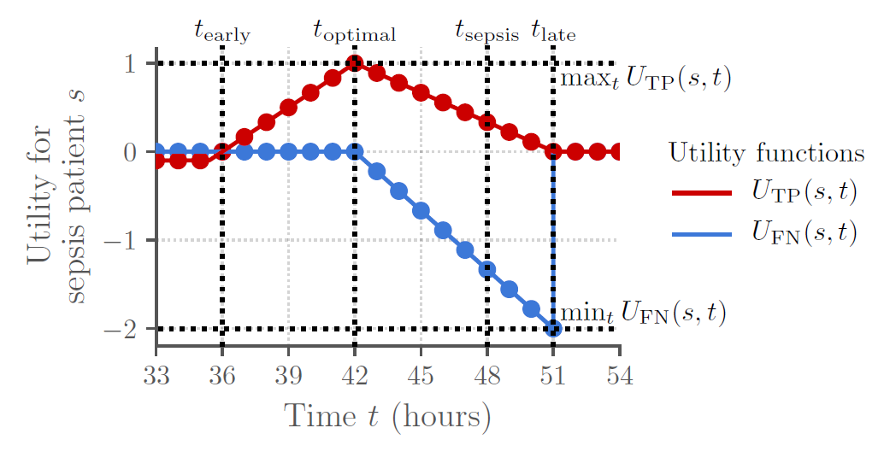
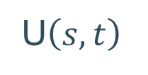
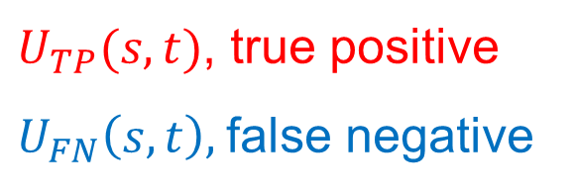
Utility Score
Prediction SepsisLabel | 1 | 0
1 | True positive | False negative
0 | False positive | True negative
$U_{TP}(s,t)$, true positive
$U_{FN}\left(s,t\right),$false negative
U$\left(s,t\right)$
s – patient id
t - time
[1] Reyna, M., Josef, C., Jeter, R., Shashikumar, S., Moody, B., Westover, M. B., Sharma, A., Nemati, S., & Clifford, G. (2019). Early Prediction of Sepsis from Clinical Data -- the PhysioNet Computing in Cardiology Challenge 2019 (version 1.0.0). PhysioNet. https://doi.org/10.13026/v64v-d857.https://physionet.org/content/challenge-2019/1.0.0/
Notes:
Rui:
The prediction can be 1 or 0 for an hour. Here the sepsis label is 1, the prediction is either true positive or false negative.
the red line stands for the utility score for the true positive. the predication is correct, thus the utility score is positive. From t early to t late, it is always positive. The closer to t optimal the higher it is.
the blue line stands for the utility score for the is false negative. The algorithm predicts a sepsis patient to be non-septic. This is very dangerous for the patient. Thus, after t optimal, the utility score is negative and decreasing linearly without the bound.

Slide 17
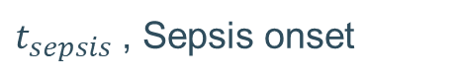


For example - septic patient utility score calculation
Time (hour(s)) | Sepsis Label | Septic Prediction (1) U(s,t) | Nonseptic Prediction (0) U(s,t)
1 | 0 | 0 | 0
2 | 0 | 0 | 0
3 | 0 | 0 | 0
… | … | … | …
42 | 0 | +1 | 0
43 | 0 | +8/9 | -2/9
44 | 0 | +7/9 | -4/9
45 | 0 | +6/9 | -6/9
46 | 0 | +5/9 | -8/9
47 | 0 | +4/9 | -10/9
48 | 1 | +3/9 | -12/9
49 | 1 | +2/9 | -14/9
50 | 1 | +1/9 | -16/9
51 | 1 | 0 | -2
$t_{optimal}$, 6 hours before onset
Good time for sepsis prediction
$t_{sepsis}$ , Sepsis onset
$t_{late}$ , 3 hours before
Notes:
Rui
So now we know the utility score for each hour. You can see it in the table. Due to the page limit, we only showed

Slide 18
For example - nonseptic patient utility score calculation
Time (hour(s)) | Sepsis Label
1 | 0
2 | 0
3 | 0
… | …
42 | 0
43 | 0
44 | 0
45 | 0
46 | 0
47 | 0
48 | 0
49 | 0
50 | 0
51 | 0
Notes:
Rui:
The above example is for septic patient, Here is the case for the a nonseptic patient and the sepsis label is always 0.

Slide 19
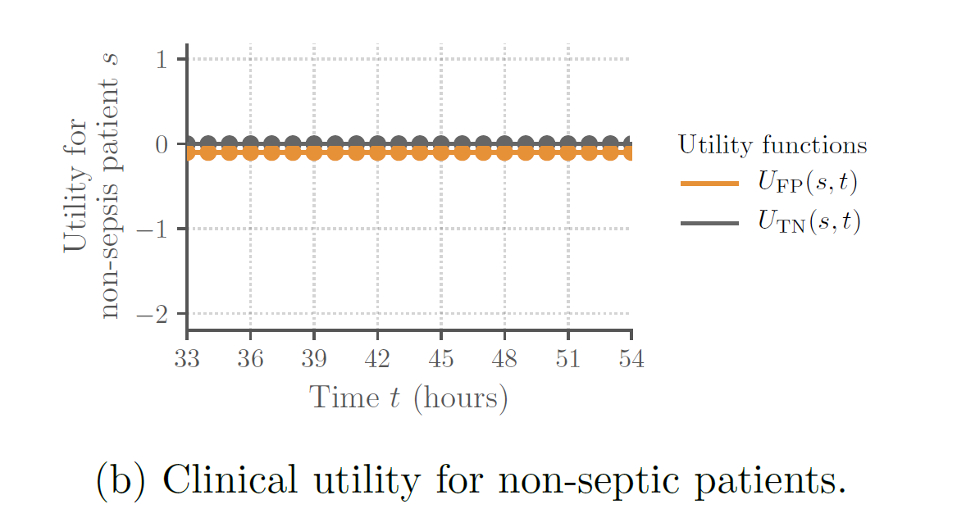
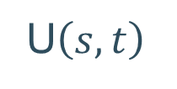
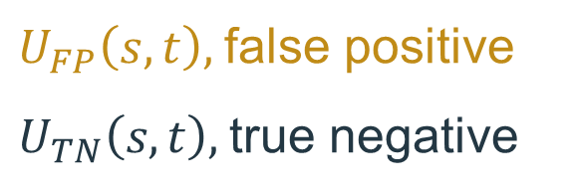
Utility Score
Prediction SepsisLabel | 1 | 0
1 | True positive | False negative
0 | False positive | True negative
$U_{FP}\left(s,t\right),$false positive
$U_{TN}\left(s,t\right),$true negative
U$\left(s,t\right)$
s – patient id
t - time
[1] Reyna, M., Josef, C., Jeter, R., Shashikumar, S., Moody, B., Westover, M. B., Sharma, A., Nemati, S., & Clifford, G. (2019). Early Prediction of Sepsis from Clinical Data -- the PhysioNet Computing in Cardiology Challenge 2019 (version 1.0.0). PhysioNet. https://doi.org/10.13026/v64v-d857.https://physionet.org/content/challenge-2019/1.0.0/
Notes:
Rui:
Here the patient is non sepsis and sepsis label is 0, the prediction is either false positive or true negative.
the brown line stands false positive. The algorithm predicts a non-septic the patient to be septic. Although it is not harmful, it will create alarm fatigue, may make the physician annoyed and waste hospital resources. Thus, the score is slightly negative.
the black line stands for true negative. The algorithm predicts a non-sepsis patient to be non-septic. The score for this case is zero.

Slide 20
For example - nonseptic patient utility score calculation
Time (hour(s)) | Sepsis Label | Septic Prediction (1) U(s,t) | Nonseptic Prediction (0) U(s,t)
1 | 0 | -0.002 | 0
2 | 0 | -0.002 | 0
3 | 0 | -0.002 | 0
… | … |  | …
42 | 0 | -0.002 | 0
43 | 0 | -0.002 | 0
44 | 0 | -0.002 | 0
45 | 0 | -0.002 | 0
46 | 0 | -0.002 | 0
47 | 0 | -0.002 | 0
48 | 0 | -0.002 | 0
49 | 0 | -0.002 | 0
50 | 0 | -0.002 | 0
51 | 0 | -0.002 | 0
Notes:
Rui:
And here is the table showing the score.

Slide 21



Utility Score
Calculate the utility score for each row ( for each hour of each patient)
Add up and normalize it
$$U_{TOTAL}=\sum_{s∈S}{\sum_{t∈T(s)}{U(s,t)}}$$
$${ U}_{normalized}=\frac{U_{total}−U_{no predictions}}{U_{optimal}−U_{no predictions}}∈[−1, 1]$$
$${ U}_{no prediction} :all predictions are 0$$
$$U_{optimal}: all predictions are correct$$
[1] Reyna, M., Josef, C., Jeter, R., Shashikumar, S., Moody, B., Westover, M. B., Sharma, A., Nemati, S., & Clifford, G. (2019). Early Prediction of Sepsis from Clinical Data -- the PhysioNet Computing in Cardiology Challenge 2019 (version 1.0.0). PhysioNet. https://doi.org/10.13026/v64v-d857.https://physionet.org/content/challenge-2019/1.0.0/
Notes:
Rui:
After calculating the utility scores for each row. Add them all up and we can get the total utility score. Then normalize it and we can get our final utility score for the algorithm. . It is a value between -1 to 1
Here U no prediction and U optimal are two constants, represent the worst and the best algorithm, one only gives 0, one only give correct prediction.

Slide 22
Overview
Introduction
Problem description
Goals
Research
Experiments
Conclusion
Notes:
Rui
Next Jeroen will discuss about the literature study we did before we began our experiments.

Slide 23

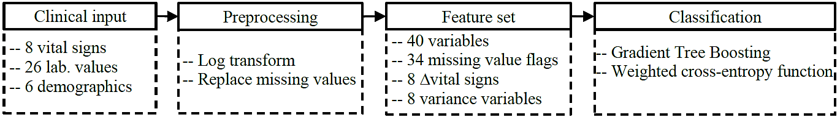
Research: PhysioNet Challenge
Author | Approach | Algorithm | Final Score Cross validation Hidden Score [-1,1]
James Morrill¹ | Signature transformation (risk score since admission) | Gradient Boosting | 5-fold 0.430 ± 0.018 | 0.360 (highest)
John Anda² |  | Gradient Boosted Decision Trees | 10-fold 0.4004 (std missing) | 0.345
Morteza Zabihi³ | Feature extraction Feature selection (both from valid & missing data) and classification | XGboost Models | 5-fold 0.4281± 0.0215 | 0.339
Xiang Li⁴ | Time PhAsed model for Sepsis Predict (TASP) 1-9h: gradient boosting tree; 10-49h: tree model 50+ h: Capture long-term dependencies | TASP (Light GBM + RNN) (10-fold CV) | 10-fold 0.4149 ± 0.0291 | 0.337
Janmajay Singh⁵ | XGBoost model with sliding window of 5, no imputation | XGBoost Model | 5-fold 0.4402 ± 0.01966 | 0.337
1 Morrill, James, et al. "The signature-based model for early detection of sepsis from electronic health records in the intensive care unit." 2019 Computing in Cardiology (CinC). IEEE, 2019.
2 Du, John Anda, Nadi Sadr, and Philip de Chazal. "Automated prediction of sepsis onset using gradient boosted decision trees." 2019 Computing in Cardiology (CinC). IEEE, 2019.
3 Zabihi, Morteza, Serkan Kiranyaz, and Moncef Gabbouj. "Sepsis prediction in intensive care unit using ensemble of XGboost models." 2019 Computing in Cardiology (CinC). IEEE, 2019.
4 Li, Xiang, et al. "TASP: A Time-Phased Model for Sepsis Prediction." 2019 Computing in Cardiology (CinC). IEEE, 2019.
5 Singh, Janmajay, et al. "Utilizing Informative Missingness for Early Prediction of Sepsis." 2019 Computing in Cardiology (CinC). IEEE, 2019.
Notes:
Jeroen:
thesis based on a computing challenge,
look how the submissions dealt with this sepsis prediction problem.
In the table shows the Top 5 papers of PhysioNet Challenge
Since high missing data, both missing data impution and sepsis prediction performed
They fill the missing data with different methods. Like forward filling and mean filling.
For the sepsis prediction, they use different techniques to boosting the data, like sliding window attributes, adding additional attributes, select the top5 features.
A detailed research can be found in the
Timely prediction: different machine learning models: examples gradient boosting, decision trees, XGBoost, and combination of models
Top paper achieves a utility score of 0,43 on the provided dataset and 0,36 on the hidden dataset.
The final score: 0.3 to 0.4. Utility score is ranging from -1 to 1.

Slide 24
Overview
Introduction
Problem description
Goals
Research
Experiments
Conclusion
Notes:
Jeroen:
Next we will discuss our experiments and results.

Slide 25
Experiments
Experiments missing data imputation
Discussion of data imputation methods
Experiments early detection
Forward wrapping improving of utility score
Experiments for improving utility score
Notes:
Jeroen
Like previously mentioned, thesis goals are reliable missing data imputation and reliable timely sepsis prediction
For achieving the thesis goals, we performed experiments for each goal
First perform experiments for filling missing data.
Secondly discussion of the early sepsis detection “algorithm”
Finally, discussion of improvement to utility score after submission

Slide 26
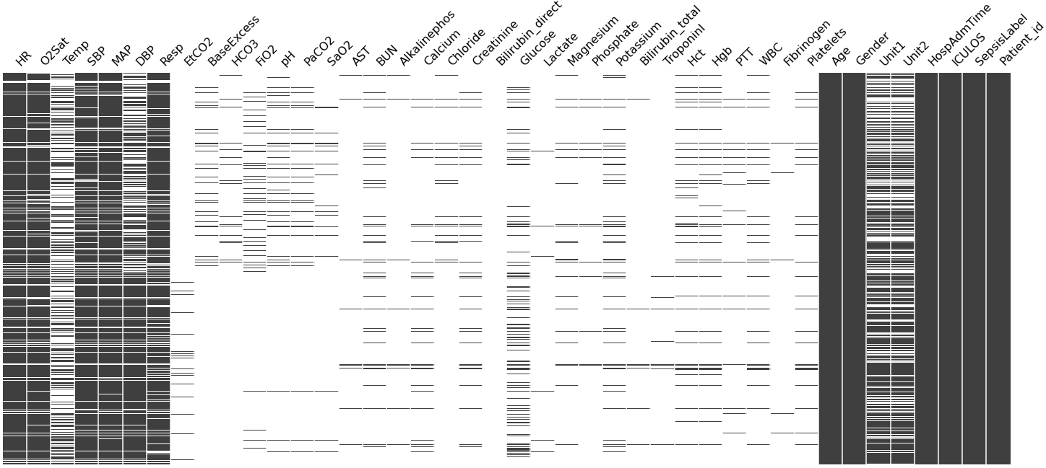
Experiments missing data imputation
A lot of missing data
Insufficient data for prediction
Laboratory values
Impute missing data
Notes:
Jeroen
To address the first goal of this thesis, performs experiments for filling the missing data reliably
Since a lot of data is missing => not “accurate” prediction can be made
Laboratory values: mainly missing

Slide 27
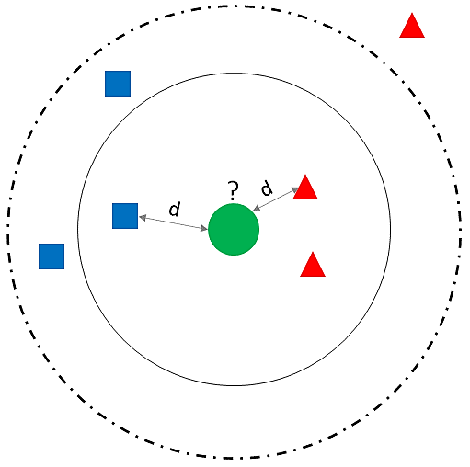
Experiments missing data imputation
KNN
Fill with mean of K nearest neighbours
Different K’s
Computational expensive
Mean Filling
Fill with feature mean
Decision Tree – 5000 patients
K | 210
UtilityScore_mean | 0.071
UtilityScore_std | 0.033
Total time (sec) | 47795.27
Raw_data | Temp | NaN | NaN | NaN | NaN | NaN | NaN | 36.11 | NaN | NaN | NaN | 37.17
KNN Fill | Temp | 37.13 | 37.23 | 37.17 | 37.20 | 37.22 | 37.22 | 36.11 | 37.24 | 37.20 | 37.21 | 37.17
Dataset size (mean) | 5000 | Set_A
Classifier(s) | DT | DT
UtilityScore_mean | 0.091 | 0.088
UtilityScore_std | 0.021 | 0.016
Total time (sec) | 77.820 | 1313.90
Raw_data | Temp | NaN | NaN | NaN | NaN | NaN | NaN | 36.11 | NaN | NaN | NaN | 37.17
Mean Fill | Temp | 36.94 | 36.94 | 36.94 | 36.94 | 36.94 | 36.94 | 36.11 | 36.94 | 36.94 | 36.94 | 37.17
Notes:
Jeroen
For the imputing the missing data, we used several methods
KNN
Uses mean of K nearest neighours
See figure right side, green dot is missing let’s say K= 3, the mean is taken from the values of the inner circle
very computational expensive and take a long time to compute
Only run until the 5000 patient's dataset (~13h)
It uses the K samples that close to the missing value to fill it
‘k’ samples in the dataset that are similar or close in the space.
Then we use these ‘k’ samples to estimate the value of the missing data points. missing values imputed using the mean value of the ‘k’-neighbors found in the dataset.
Mean:
Filling with the mean of the feature column
Run on Different patient sizes
In the table, the missing values are filled with the mean of the feature (column)

Slide 28
Experiments missing data imputation
Zero Filling
Replace NaN with 0
Forward Filling
Fill NaN values between valid values
Remaing NaN filled with Mean/Zero
Dataset size (0) | 5000 | Set_A
Classifier(s) | DT | DT
UtilityScore_mean | 0.102 | 0.094
UtilityScore_std | 0.034 | 0.013
Total time (sec) | 100.070 | 398.900
Raw_data | Temp | NaN | NaN | NaN | NaN | NaN | NaN | 36.11 | NaN | NaN | NaN | 37.17
Zero Fill | Temp | 0.0 | 0.0 | 0.0 | 0.0 | 0.0 | 0.0 | 36.11 | 0.0 | 0.0 | 0.0 | 37.17
 | FFIL_mean | FFIL_0
Dataset size | Set_A | Set_A
Classifier(s) | DT | DT
UtilityScore_mean | 0.088 | 0.050
UtilityScore_std | 0.016 | 0.029
Total time (sec) | 1313.90 | 1283.56
Raw_data | Temp | NaN | NaN | NaN | NaN | NaN | NaN | 36.11 | NaN | NaN | NaN | 37.17
FFIL_0 |  | 0.0 | 0.0 | 0.0 | 0.0 | 0.0 | 0.0 | 36.11 | 36.11 | 36.11 | 36.11 | 37.17
FFIL_mean |  | 36.78 | 36.78 | 36.78 | 36.78 | 36.78 | 36.78 | 36.11 | 36.11 | 36.11 | 36.11 | 37.17
Notes:
Jeroen
Discuss of Zero Filling
DecisionTree achieves highest mean utility score
Method that replaces NaN values with 0
Set_A: data from hospital 1 (20,336 patients)

Slide 29
Experiments missing data imputation
Filling methods on Full dataset
Mean & Zero Fill
Decision Tree Classifier
Results of filling experiments on full dataset
Fill method | FFIL_0 | FFIL_mean | Mean filling | Zero filling
Classifier(s) | DT | DT | DT | DT
UtilityScore_mean | 0.067 | 0.044 | 0.086 | 0.087
UtilityScore_std | 0.033 | 0.015 | 0.006 | 0.003
Notes:
Jeroen
The table shows the results of the 4 different methods for filling the missing data.
Zero and mean filling achieves the highest average utility score.
We use different classifiers but due to time we only show the best results, "For time purposes, we are not going to discus them."
Refer to Thesis
The classifier is the best presents the decision tree classifier in all 4 filling methods.
Next, college Rui is discuss the experiments & Results for reliably predict sepsis

Slide 30
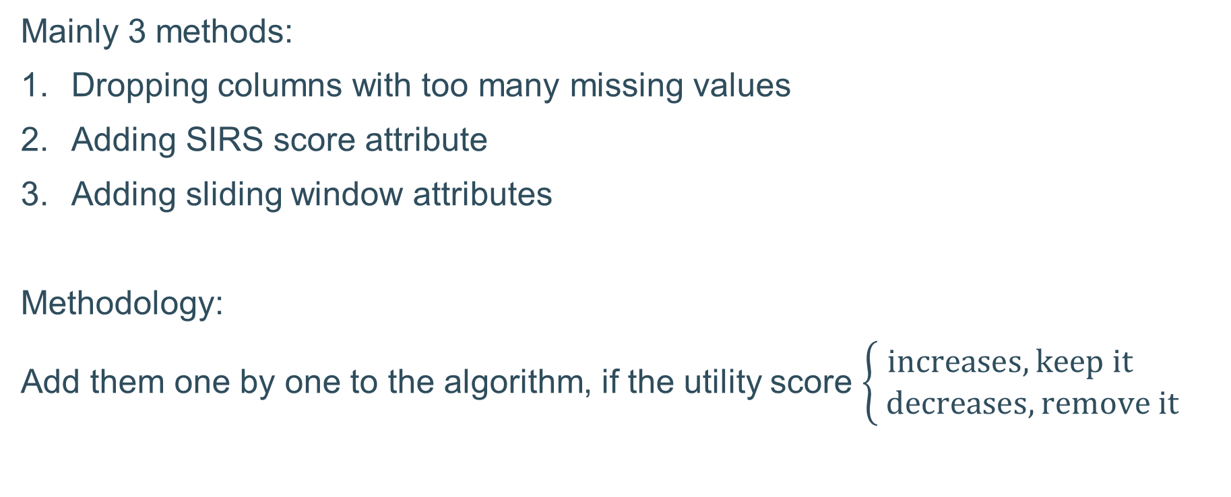
Experiments for reliably predicting sepsis
Mainly 3 methods:
Dropping columns with too many missing values
Adding SIRS score attribute
Adding sliding window attributes
Methodology:
Add them one by one to the algorithm, if the utility score $\left\{\begin{aligned}increases, keep it \\ decreases, remove it\end{aligned}\right.$
Notes:
Rui
After experiments for the data filling method, we come to developing the algorithm for reliably predicting sepsis.
To improve the utility score further, we came up with many different methods to add into our algorithm. Here we chose three to present. They are Dropping columns with too many missing values, Adding SIRS score and Adding sliding window attributes.
SIRS is an abbreviations I will introduce it later.
We add these methods one by one to the algorithm and run the model training test, if the utility score increases, we will keep this method, otherwise, we won’t integrate this methods into our algorithm. In this way we only integrate the helpful methods into our algorithm, and we can achieve the highest utility score at last.

Slide 31
Dropping columns
Column | Missing rate (%)
HR | 9.88
MAP | 12.45
… | …
Fibrinogen | 99.34
Bilirubin_direct | 99.81
Many columns are severely missing – more than 90% of the data is missing
In 42 columns, 26 columns are severely missing
Severely missing columns are unhelpful for algorithm training
Severely missing column
Notes:
Rui:
The first method is dropping columns with too many missing values. Many columns from the dataset are severely missing - more than 90% of the data is missing. In the total 42 columns, 26 columns are severely missing. These columns contain little useful information. After data filling, most values are either 0 or the repetition of a certain number of values.
They are unhelpful for the sepsis detection algorithm training, so maybe it’s better to remove them.

Slide 32
Dropping columns results
K=5, Decision Tree, forward + zero filling
Try dropping columns with missing ratio higher than
A big performance improvement!
(0.067 → 0.10)
Dropping columns with missing ratios higher than 91% or 92%
 | 90% | 91% | 92% | 93% | 94% | 100%
UtilityScore_mean | 0.087 | 0.101 | 0.100 | 0.095 | 0.069 | 0.067
UtilityScore_std | 0.021 | 0.03 | 0.03 | 0.038 | 0.024 | 0.033
F1Score_mean | 0.082 | 0.088 | 0.092 | 0.092 | 0.081 | 0.085
Accuracy_mean | 0.931 | 0.932 | 0.942 | 0.946 | 0.953 | 0.961
Notes:
Rui:
Here we tried dropping columns with missing ratios higher than 90%, 91% 92% and so on. We also tried them with different data filling methods we talked before.
Here only the results with forward filling plus zero filling data filling methods is shown. After dropping columns, it performed better than zero filling or mean filling. From the results we can see, the performance improves. The best performance is achieved when dropping columns with missing ratios > 91%, the utility score is 0.101. This is the highest score now.
For dropping columns with missing ratio lager than 92%, the utility score is nearly the same. We will keep it as an option for the later experiments.

Slide 33
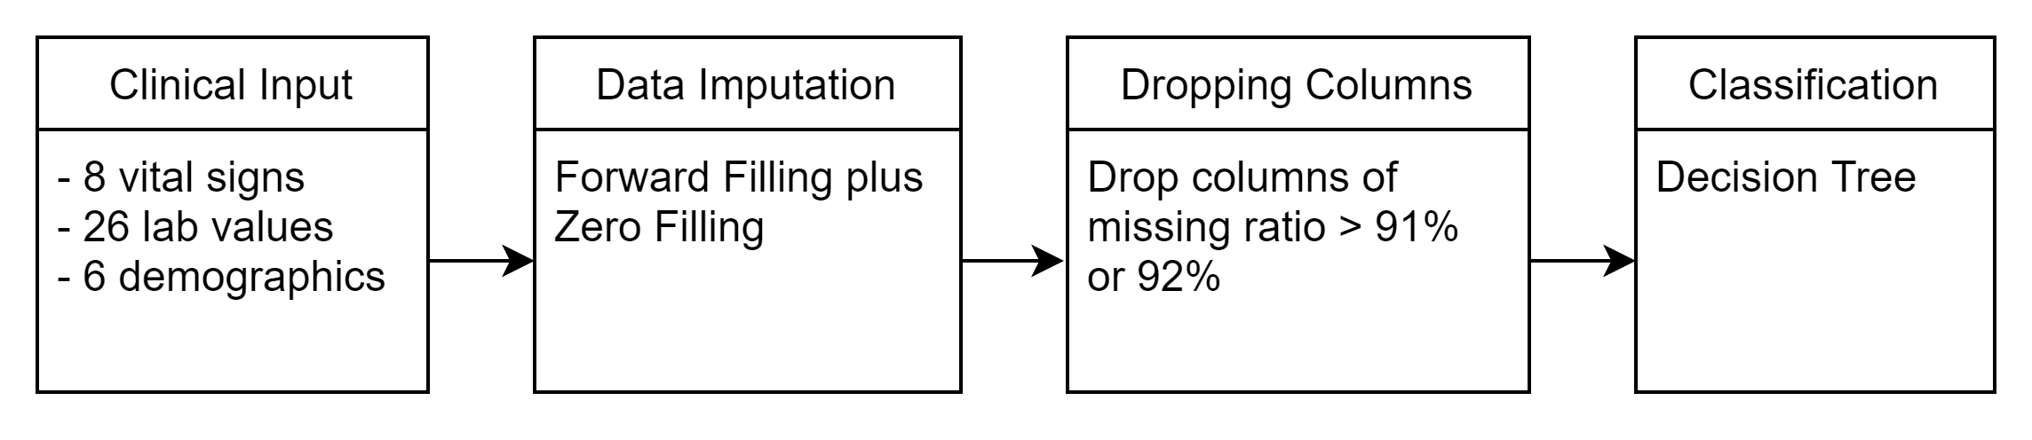
Current algorithm
Utility score = 0.101
Notes:
Rui:
So, from now on, dropping columns with missing ratio with 91%or 92% is included in our algorithm.

Slide 34
Adding SIRS score
SIRS (Systemic Inflammatory Response Syndrome) score:
Once used in the definition of sepsis
Calculated based on 4 measurements:
SIRS score = how many conditions are met (ranging 0-4)
Measurement | Condition
Temperature | < 36 °C or > 38 °C
Heart rate | > 90 beats per minute
Respiratory rate | > 20 breaths per min
White blood cell (WBC) | < 4x10⁹/L, or > 12x10⁹/L
Notes:
Rui:
The second method we tried is adding SIRS score.
SIRS score is Systemic inflammatory response syndrome score, it was once used in the definition of sepsis and related to sepsis detection. It is calculated based on 4 measurement. The table shows four conditions, SIRS score equals how many conditions are met, thus ranging from 0 to 4.

Slide 35
Adding SIRS score results
For dropping columns > 91%,
The utility score decreases
(0.101 → 0.096)
Adding SIRS is unhelpful!
 | Drop columns > 91%
 | No SIRS | Adding SIRS
UtilityScore_mean | 0.101 | 0.096
UtilityScore_std | 0.030 | 0.026
F1Score_mean | 0.088 | 0.086
Accuracy_mean | 0.932 | 0.932
Notes:
Rui:
here we Calculate the SIRS score and add it as an attribute for each sample , the utility score decreases. Thus, adding SIRS score is unhelpful and will not be included in the algorithm.

Slide 36
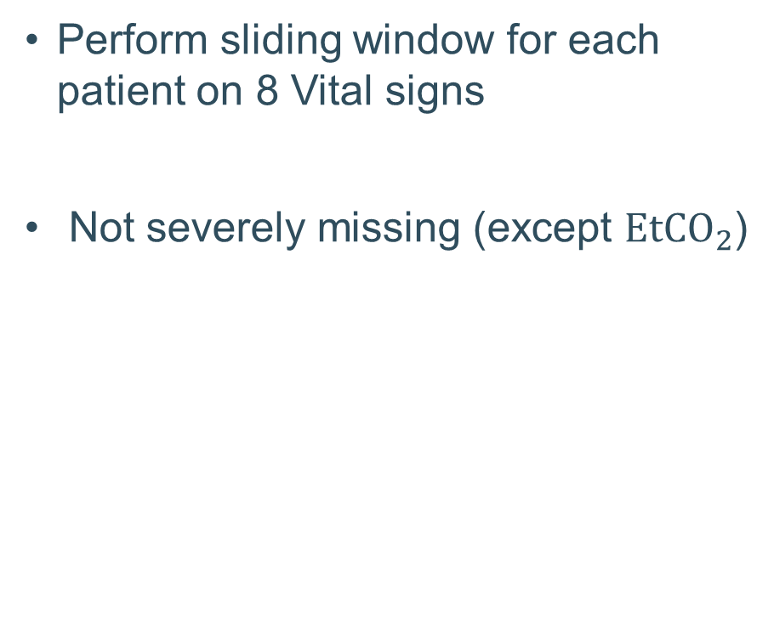
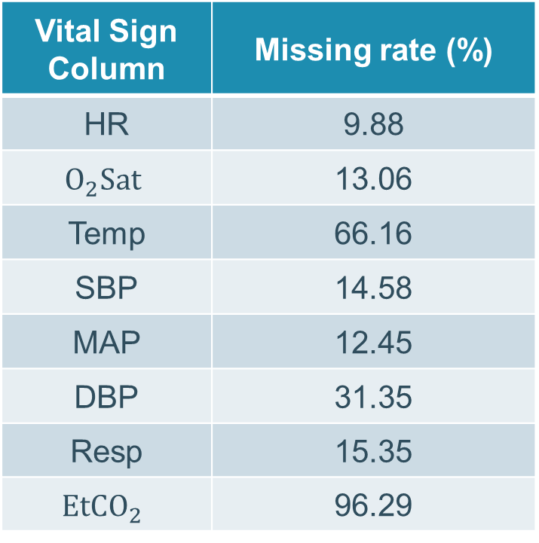
Adding sliding window attributes
Vital Sign Column | Missing rate (%)
HR | 9.88
$$O_{2}Sat$$ | 13.06
Temp | 66.16
SBP | 14.58
MAP | 12.45
DBP | 31.35
Resp | 15.35
$${EtCO}_{2}$$ | 96.29
Perform sliding window for each patient on 8 Vital signs
Not severely missing (except ${EtCO}_{2}$)
Notes:
Rui:
At last we tried adding sliding window attributes.
To include longitudinal information for each patient, using sliding window is the best candidate. Our Sliding window is performed on the 8 vital signs. From the table we can see each vita sign and its corresponding missing rate, they are not severely missing except the ${EtCO}_{2}$.

Slide 37
Adding sliding window attributes
HR
90
98
105
97
89
90
103
110
108
106
102
6 different attributes for sliding window:
1. Last hour: the last hour measurements
2. Min: min value for the last 6 hours
3. Max: max value for the last 6 hours
4. Minmaxdiff: Max - Min
5. Mean: mean value for the last 6 hours
6. Std: standard derivation for the last 6 hours
Max
6 hour
Min
Last
Now
Notes:
Rui:
Here 6 different attributes of the sliding window are chosen. They are the measurement for the last hour, min value, max value, the difference of the min and max value, the average and standard derivation for the last 6 hours measurement. The right chart gives an example of how they are calculated.

Slide 38
Adding sliding window attributes
Drop columns missing > 91%
Adding Sliding Window Attributes | None | Last hour | Min | Min+ Max | Min+ Max+ Minmaxdiff | Min+ Max+ Minmaxdiff+ Mean | Min+ Max+ Minmaxdiff+ Std
UtilityScore_mean | 0.101 | 0.078 | 0.110 | 0.113 | 0.120 | 0.107 | 0.120
UtilityScore_std | 0.030 | 0.028 | 0.019 | 0.018 | 0.020 | 0.021 | 0.016
Notes:
Rui:
Here, we add the 6 sliding window attributes one by one, keeping the helpful one and remove the unhelpful. At last, we achieved an improved utility score. Adding the min, max and Minmaxdiff gives a big improvement on the utility score. Adding the std doesn’t have an obvious influence on the performance. This table is with dropping columns with missing ratios > 91%. We will also try dropping columns with missing ratios > 92% in the next slide.

Slide 39
Adding sliding window attributes
In conclusion, the best performance achieved is 0.127
Achieved by:
Drop columns with missing ratios > 92%
Adding sliding window attributes of Min, Max, MinmaxDiff , Std
Drop columns missing > 92%
Adding Sliding Window Attributes | None | Min+ Max+ Minmaxdiff | Min+ Max+ Minmaxdiff+ Std
UtilityScore_mean | 0.100 | 0.119 | 0.127
UtilityScore_std | 0.030 | 0.029 | 0.026
Notes:
Rui:
Here after dropping columns with missing ratios > 92%, and adding the std sliding window attribute, the utility score improves further to 0.127. This is the best utility score we achieved for our master thesis.

Slide 40
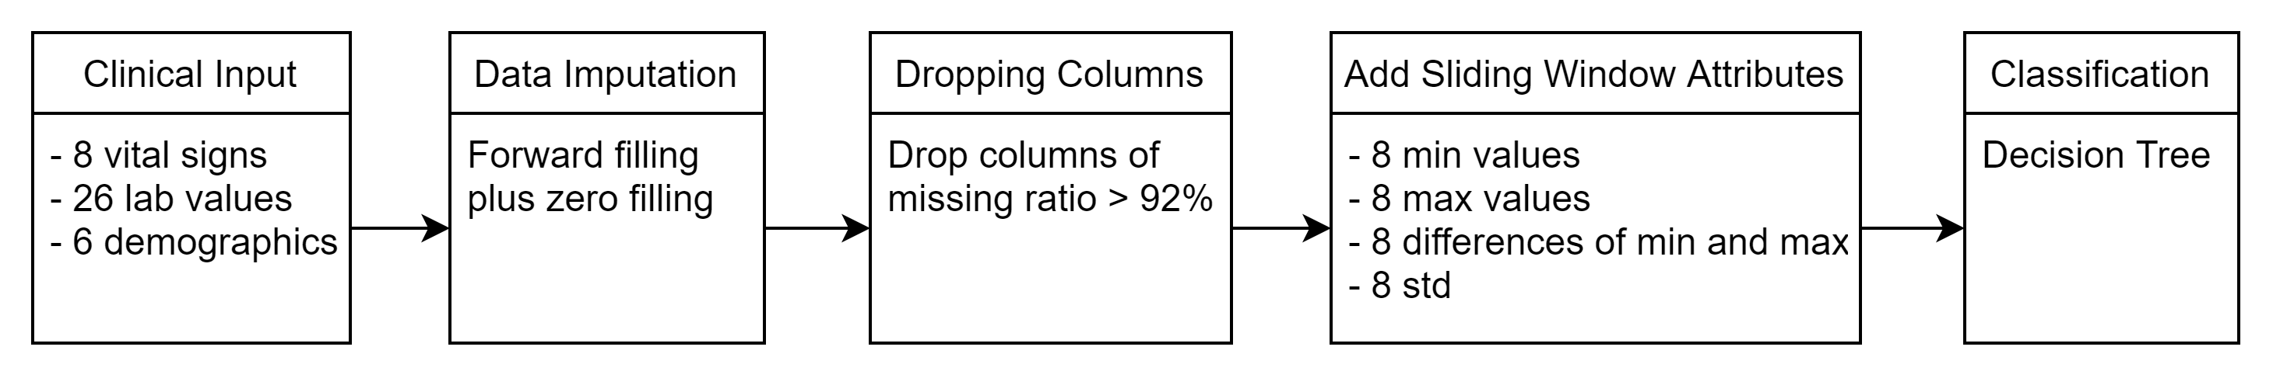
Final algorithm
Utility score = 0.127
Notes:
Rui:
After the above experiments, in conclusion, the final algorithm looks like this. With dropping columns and adding sliding window attributes, the utility score is increased to 0.127.

Slide 41
Adding sliding window attributes
Full dataset = Set_A + Set_B
Run the final algorithm on Set_A and Set_B
Final algorithm | Full data | Set_A | Set_B
UtilityScore_mean | 0.127 | 0.105 | 0.063
UtilityScore_std | 0.026 | 0.022 | 0.037
Notes:
Rui:
As we discussed before, the full dataset is composed of two different dataset, set A and set B. Before, we combined them together to be the full dataset to train a more general algorithm. Here, we tested the final algorithm separately on setA and setB. You can see the utility score is not as that high as that of the full data set. This means there is a big difference between setA and setB.

Slide 42
Conclusion
Developed an algorithm for reliably sepsis prediction
Forward + Zero Filling
Drop 92% + Sliding windows
Decision Tree
K-Fold of 5
Utility score: 0.127
PhysioNet: 0.430
Notes:
Rui:
In conslusion, the Forward + Zero Filling stands out to be a better data filling method. Together with dropping columns with missing ratio larger than 92% , adding the sliding window attributes, decision tree training model and Kfold with 5, we achieved the utility score of 0.127 at last for our master thesis.
Next my colleague Jeroen will discuss about the further improvements we achieved after the submission of the thesis.

Slide 43
Experiments for improving utility score
Balancing dataset
Sepsis ~ non-sepsis
Oversample
Run on Set_A & B
Original classifiers
SetA-FFIL_0-Drop91% Sliding Window balance after fill | GRAD | LGBM
UtilityScore_mean | 0.3601 | 0.35
UtilityScore_std | 0.0181 | 0.0231
SetB-FFIL_0-Drop91% Sliding Window-balance after fill | GRAD | LGBM
UtilityScore_mean | 0.1405 | 0.1678
UtilityScore_std | 0.0415 | 0.038
Notes:
Jeroen
Since the dataset is balanced, we opted to balance the amount of sepsis patients to the same level as the non-sepsis patient
Results of balancing dataset using sliding window LAST-MIN-MAX-MEAN
Balance Set_A
F1Score_std: 0.024-0.0097-0.0062-0.0049
AUROC_mean 0.0 - 0.5918-0.7719-0.7609
AUPRC_mean: 0.0-0.0418-0.0956-0.0883
Accuracy_std: 0.0047-0.0087-0.0123-0.0084
Balance Set_B:
F1Score_std: 0.0086-0.0061-0.0083-0.006
Accuracy_std: 0.002-0.0042-0.0088-0.0094
AUROC_mean: 0.0-0.6008-0.7371-0.7413
AUPRC_mean: 0.0-0.0339-0.0591-0.0571

Slide 44
Experiments for improving utility score
setA-drop91%-Sliding window | EnsembleDT | EnsembleXGB | EnsembleLGBM | Balanced DT
UtilityScore_mean | 0.0898 | 0.326 | 0.3803 | 0.0412
UtilityScore_std | 0.0218 | 0.0099 | 0.0257 | 0.0114
Ensemble classifiers
XGBoost
LGBM
Run on Full data
DT
LGBM
FULL-drop91% Sliding Window | Ensemble DT | EnsembleXGB | EnsembleLGBM | BalancedDT | BalancedXGB | BalancedLGBM | EnsembleGRAD
UtilityScore_mean | 0.2644 | 0.3979 | 0.4035 | 0.2514 | 0.3948 | 0.4077 | 0.4026
UtilityScore_std | 0.008 | 0.0185 | 0.0208 | 0.0091 | 0.0215 | 0.0202 | 0.0225
Notes:
Improving utility score using ensemble classifiers
In the 5 fold cross validation loop, the second classifiers used is trained using the errors and faults of the previous classifier
combining several models
SW-LAST-min-max-mean-
Balanced-(Bagging Classifier): create balanced samples of input
0,7386 0,8337 0,839 0,7431 0,8333 0,8392 0,8344 0,0589 0,1052 0,111 0,0617 0,1057 0,1127 0,1081

Slide 45
Conclusion improved utility score
Balancing
Ensemble classifier
 | Original | Balancing
Set_A | 0.105 | 0.360
Set_B | 0.063 | 0.140
 | Original | Ensemble Classifier
Set_A | 0.105 | 0.380
Set_B | 0.063 | 0.282
Full data | 0.127 | 0.403
Notes:
Jeroen
Original utility score 0,127
Balancing dataset achieves using oversample and XGBOOST
Utility score of 0,36 and 0,1405
Ututlityy
Ensemble classifier: ensemble LGBM
Set A_-B-full: 0.38-0.282-0.403

Slide 46
Any question?

Slide 47
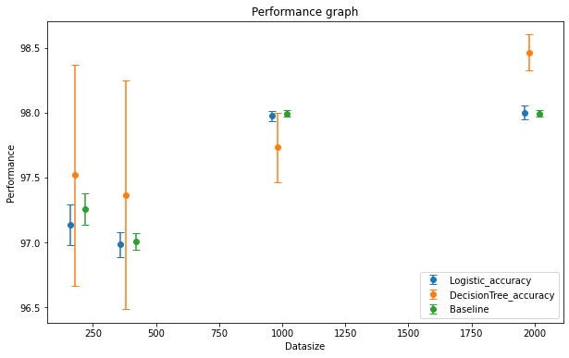
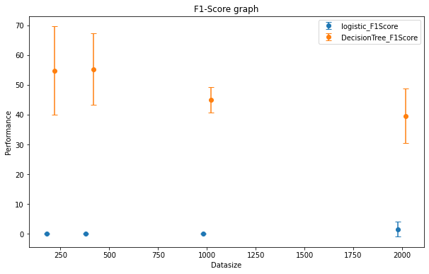
Already realized
10-fold Cross validation
Notes:
Jeroen
Comparison of performance of two classifiers and a baseline [majority labels]
- the error of all the classifiers reduces as we increase the data size;
Decision trees starts to perform better in terms of accuracy
Baseline is there because of the imbalanced dataset;
F1-score : (2*precision*recall)/(precision+recall).
Decision Tree classifier has a higher F1-score. Better suited for getting "better"/ accurate results.
precision is the fraction of retrieved documents that are relevant to the query
Recall: fraction of the relevant documents that are successfully retrieved
Logistic Regression: doesn’t perform very well
Utility score not yet implemented
Logistic Regression gives bad performance
Decision Tree, XGBoost gives better result

Slide 48
Data description (Backup)
The Utility Score metric was defined such that a positive utility score could be achieved by making a correct sepsis prediction up to 6 hours before t_{optimal} and about 12 hours before t_{sepsis}. Since we used a non-sequential model and our window size was relatively small, we decided to shift the Sepsis Labels further back to encourage even earlier predictions. That is for Sepsis patients, SepsisLabel = 1 if t >t_{sepsis} - (6+k) and SepsisLabel= 0 if t < t_{sepsis} - (6 + k). We experimented with several values of k and found that k = 3 resulted in the maximum Utility Score on our local testing set.
[1] Reyna, M., Josef, C., Jeter, R., Shashikumar, S., Moody, B., Westover, M. B., Sharma, A., Nemati, S., & Clifford, G. (2019). Early Prediction of Sepsis from Clinical Data -- the PhysioNet Computing in Cardiology Challenge 2019 (version 1.0.0). PhysioNet. https://doi.org/10.13026/v64v-d857. https://physionet.org/content/challenge-2019/1.0.0/
Notes:
Back up slide for explaining why 6 hours ahead
Explain 6 hours ahead
Sepsis labels shifted six hours ahead
Predict sepsis 6 hours early

Slide 49
Already realized
Work on Jupyter notebook with Python
Fill missing data:
KNN: K-nearest neighbors (currently experimenting with)
Mean: the overall average value
Fill up: suppose the data was changing linearly for every patient
Cross validation
10-fold
Evaluate the performance.
Notes:
RUI
KNN: replacing the missing data by mean value of its nearest K neighbors, currently experimenting with it
Mean: just replace the missing with the overall average mean value
Fill up: suppose the data was changing linearly for every patient
Cross validation
= Split data into train & test set
estimate how accurately a predictive model will perform in practice
known data on which training is run (training dataset), and a dataset of unknown data tested against the model is tested

Slide 50
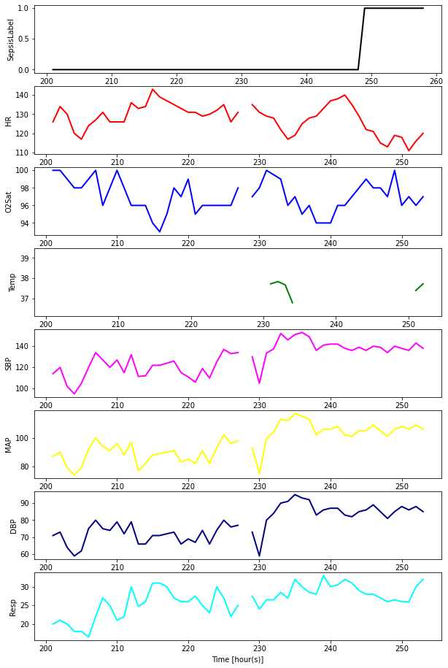
Experiments missing data imputation
Provided dataset contains lot of missing data
Not enough data for prediction
Not reliably early detection
imputation methods
Notes:
Jeroen

